Slide 1

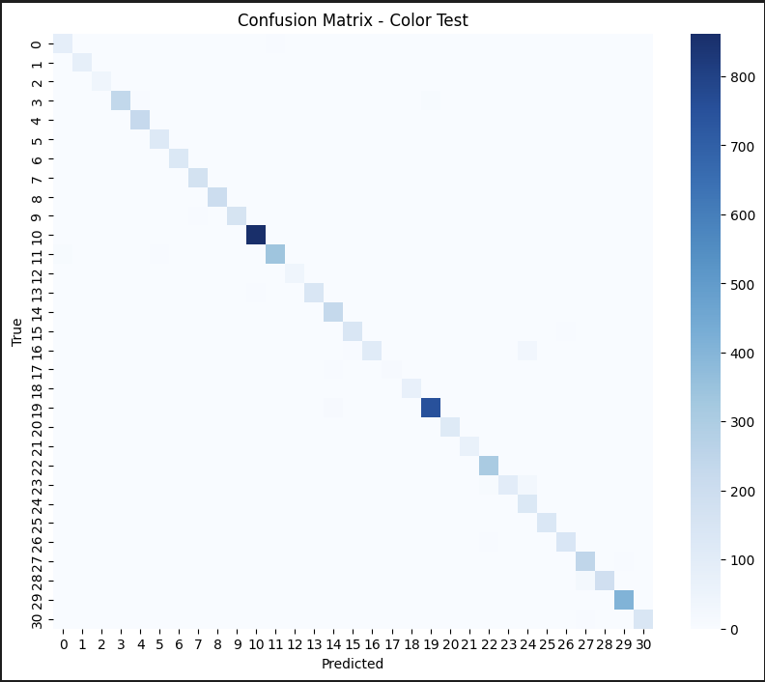
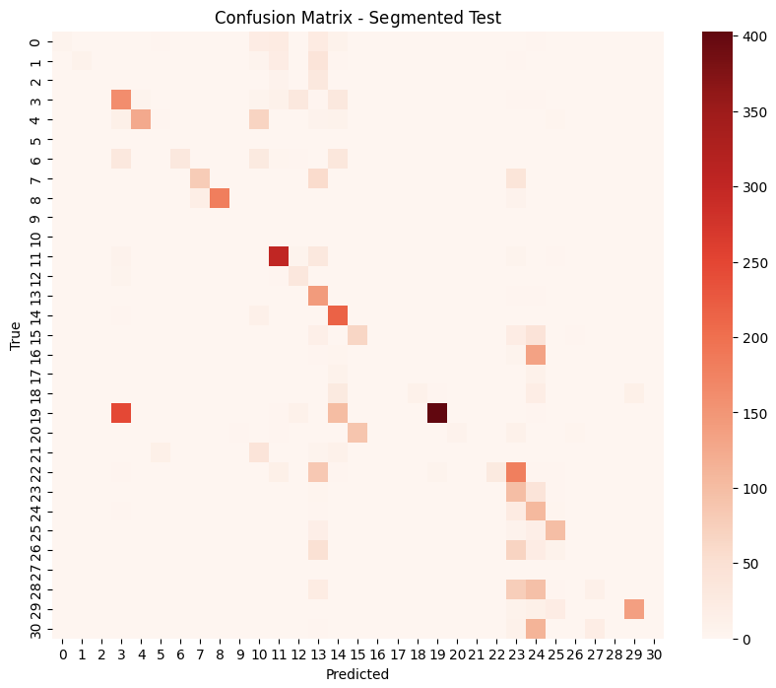
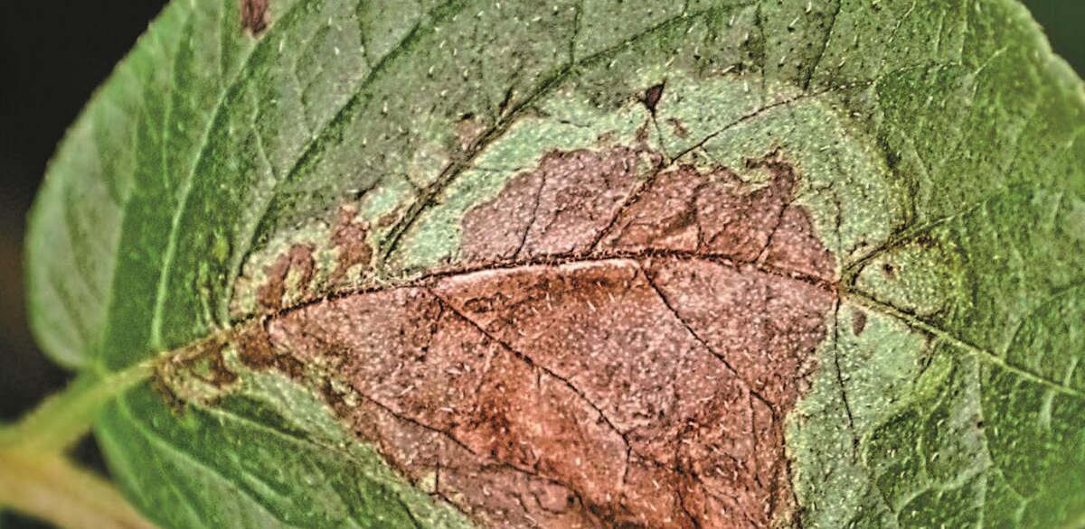
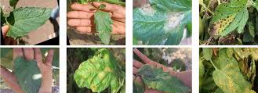
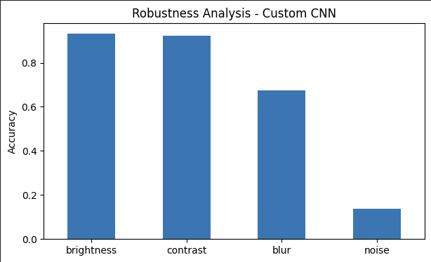
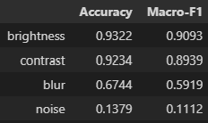
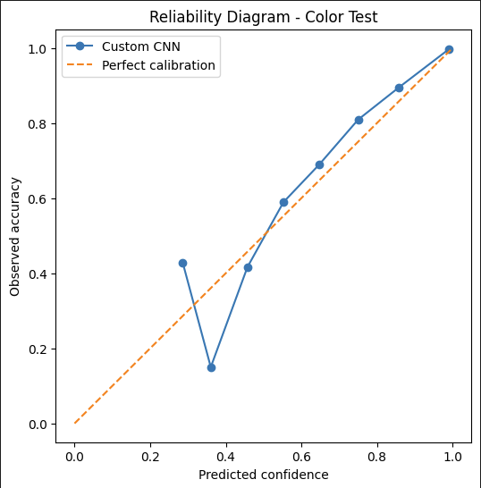
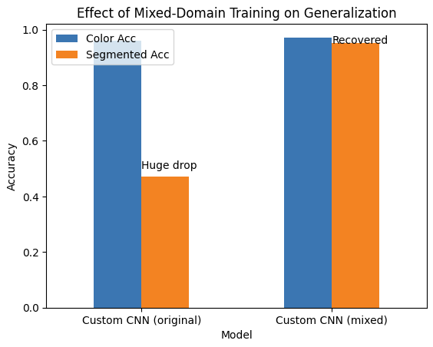
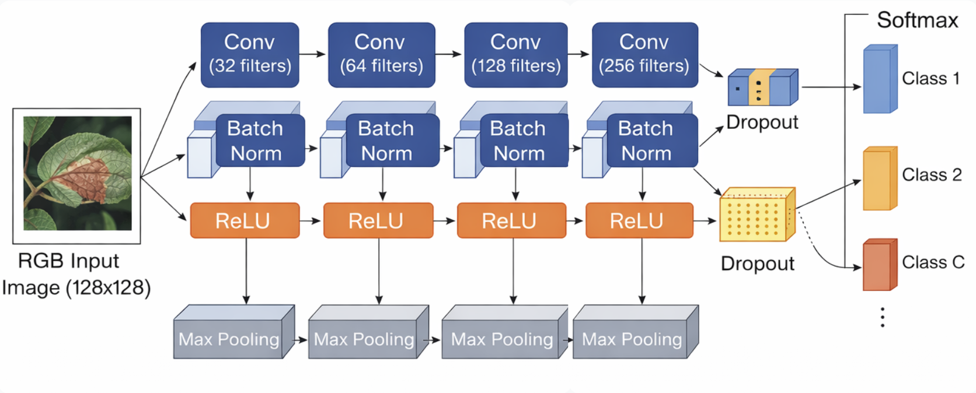
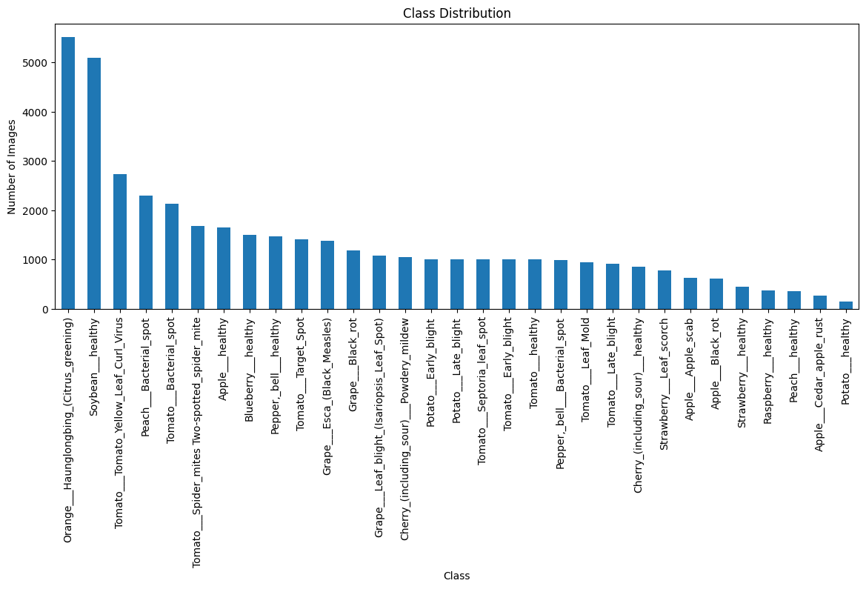
AI Student Symposium 2026
ECE525
Team 81
Robust Plant Disease Classification Under Real-World Distribution Shifts
Team 81: Luisa Chavez, Chase Wrenn, Joyce Zhou
Problem Statement
Baseline: Logistic Regression
Evaluation Results
●Hyperparameter Choice:
○Regularization
○Convergence
○Solver Type
●Test Process: 192 Initial Candidates, 32 Final Candidates
●Best Candidate Accuracy: ~63.65%
●Optimal Parameters: SAGA solver, 0.05 convergence tolerance, regularization strength of 1
Color Test (Clean Data):
Accuracy: 0.96 | Macro-F1: 0.94
Segmented Test (Shifted Data):
Accuracy: 0.47 | Macro-F1: 0.30
Motivation:
Major cause of crop yield loss
Early detection is critical
Automated diagnosis is scalable
Task: multi-class classification
Input: RGB image of a leaf
Output: disease category (probability over classes)
Confusion Matrix - Color Test
Confusion Matrix - Segmented Test
20-40% global yield loss [1]
192 Candidate Models
32 Final Models
- High performance on clean data.
- Severe drop under distribution shift
$220B+ annual economic losses globally [1]
Optimal Model (Baseline)
Robustness Analysis:
- Robust to brightness & contrast
- Degrades under blur
- Severe drop with noise
Data
Hyperparameter Tuning
Plant Village Dataset [2]
~ 50k images across 38 classes
Built metadata from raw images
Introduced leaf_id to group images from the same leaf
Leaf-level split
Prevents data leakage
Avoids nearly identical images across splits
After Cleaning: ~42k images, 8k leaves, 31 classes
Notice some Class imbalance → accuracy not sufficient
CNN Model
Calibration (Reliability)
Generalization Improvement:
- Model is reasonably calibrated.
- Slight overconfidence at mid-confidence
-Mixed-domain training recovers performance under distribution shift.
- Strongly reduces the generalization gap
Conclusions
Models trained on clean data fail under distribution shifts, revealing a significant generalization gap.
Mixed-domain training significantly improves performance, showing that data diversity is key for real-world robustness.
Robustness evaluation is essential, as benchmark accuracy alone can be misleading in real-world settings.
Designed to balance model capacity vs generalization
Custom CNN with 4 convolutional blocks
Filters: 32 → 64 → 128 → 256
Each block: Conv + BatchNorm + ReLU + MaxPool
Dropout used in fully connected layers
Input size: 128×128 RGB images
Output: Softmax over 31 classes
Main References
FAO. Plant Production and Protection Division, 2021. https://www.fao.org/plant-production-protection/
PlantVillage Dataset, Mohanty et al., 2016. https://github.com/spMohanty/PlantVillage-Dataset
Crop leaf images from real field conditions. ResearchGate. https://www.researchgate.net/
Notes:
Note: font size prefer to be 36pts and above

